Slide 1
Two Year DFAM Beetle Management Summary
Bulkley TSA
2003-2004

Slide 2
Babine BMU

Slide 3
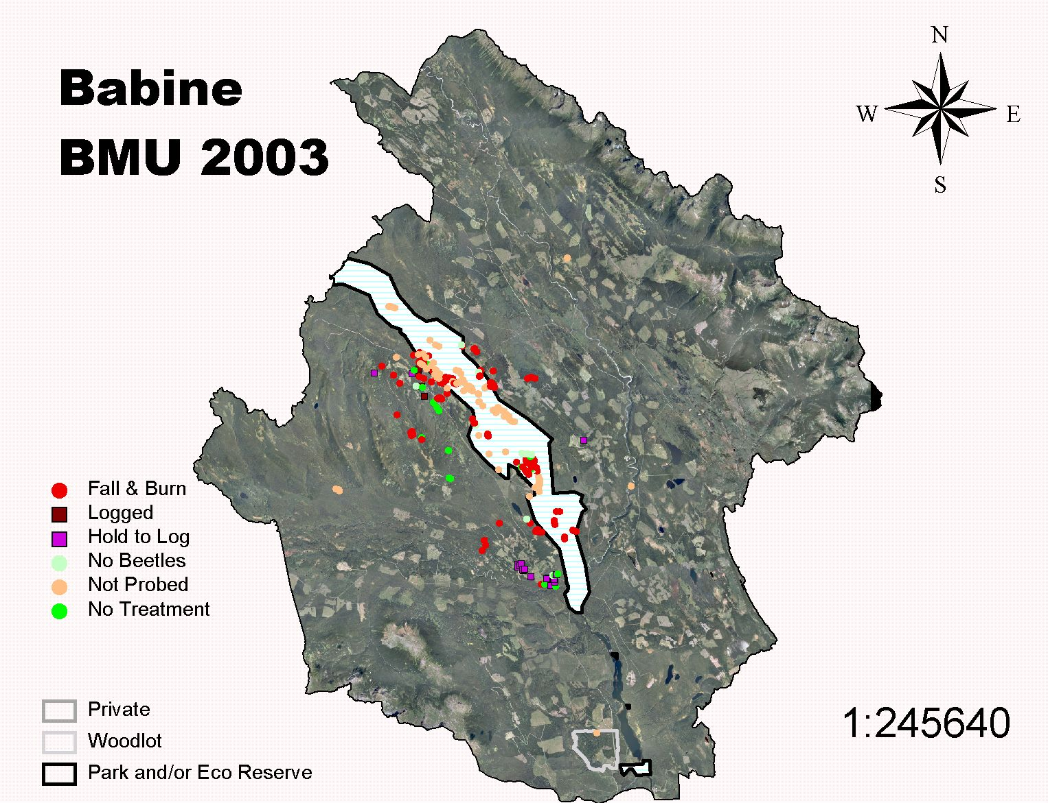
Babine BMU 2003

Slide 4
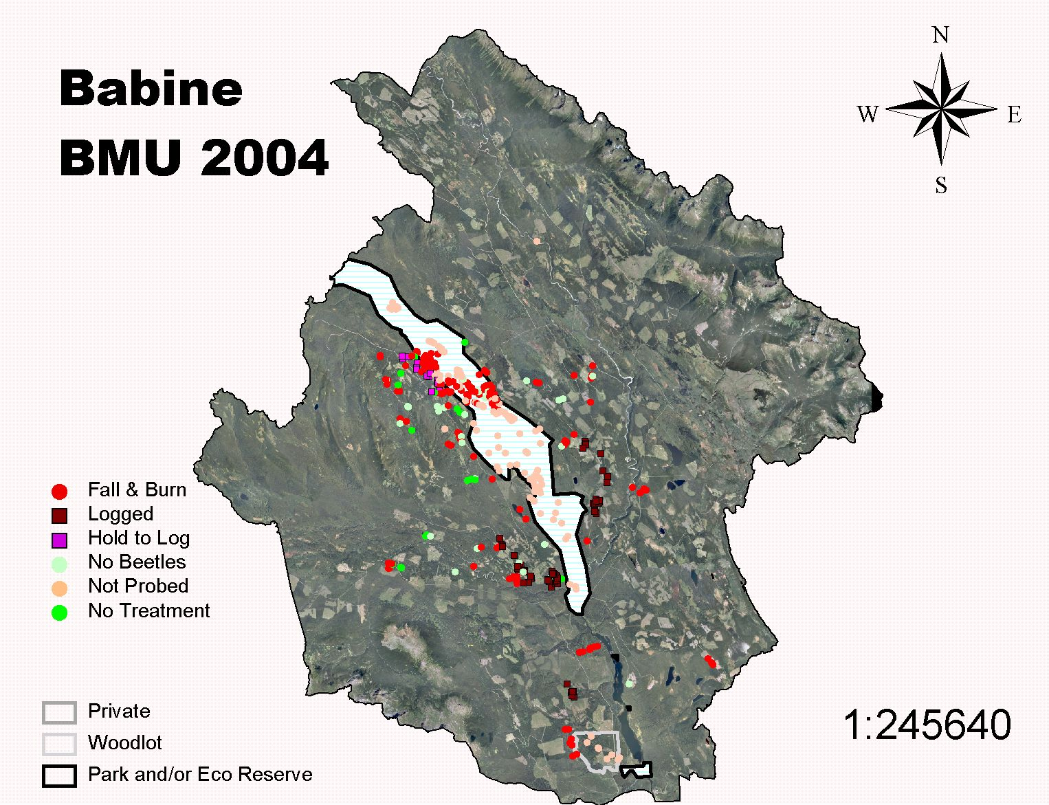
Babine BMU 2004

Slide 5
Blunt BMU

Slide 6
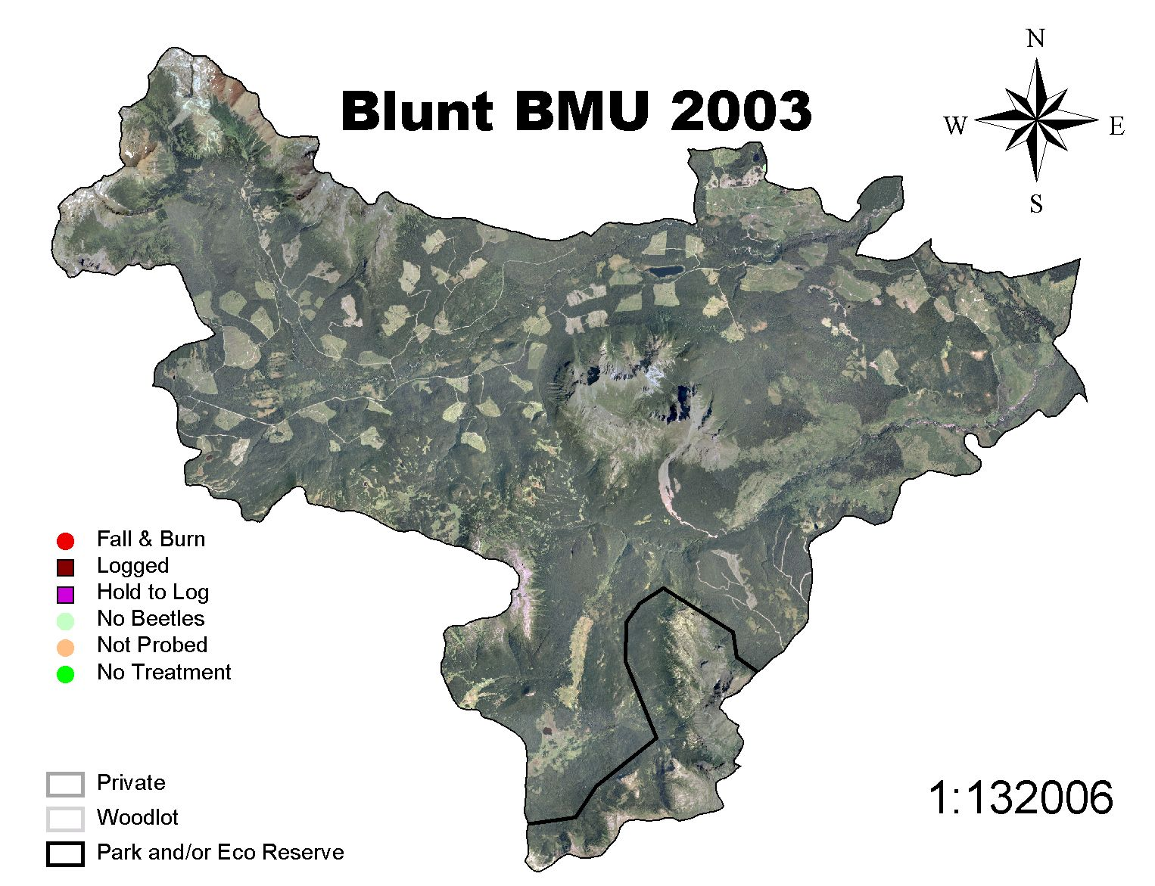
Blunt BMU 2003

Slide 7
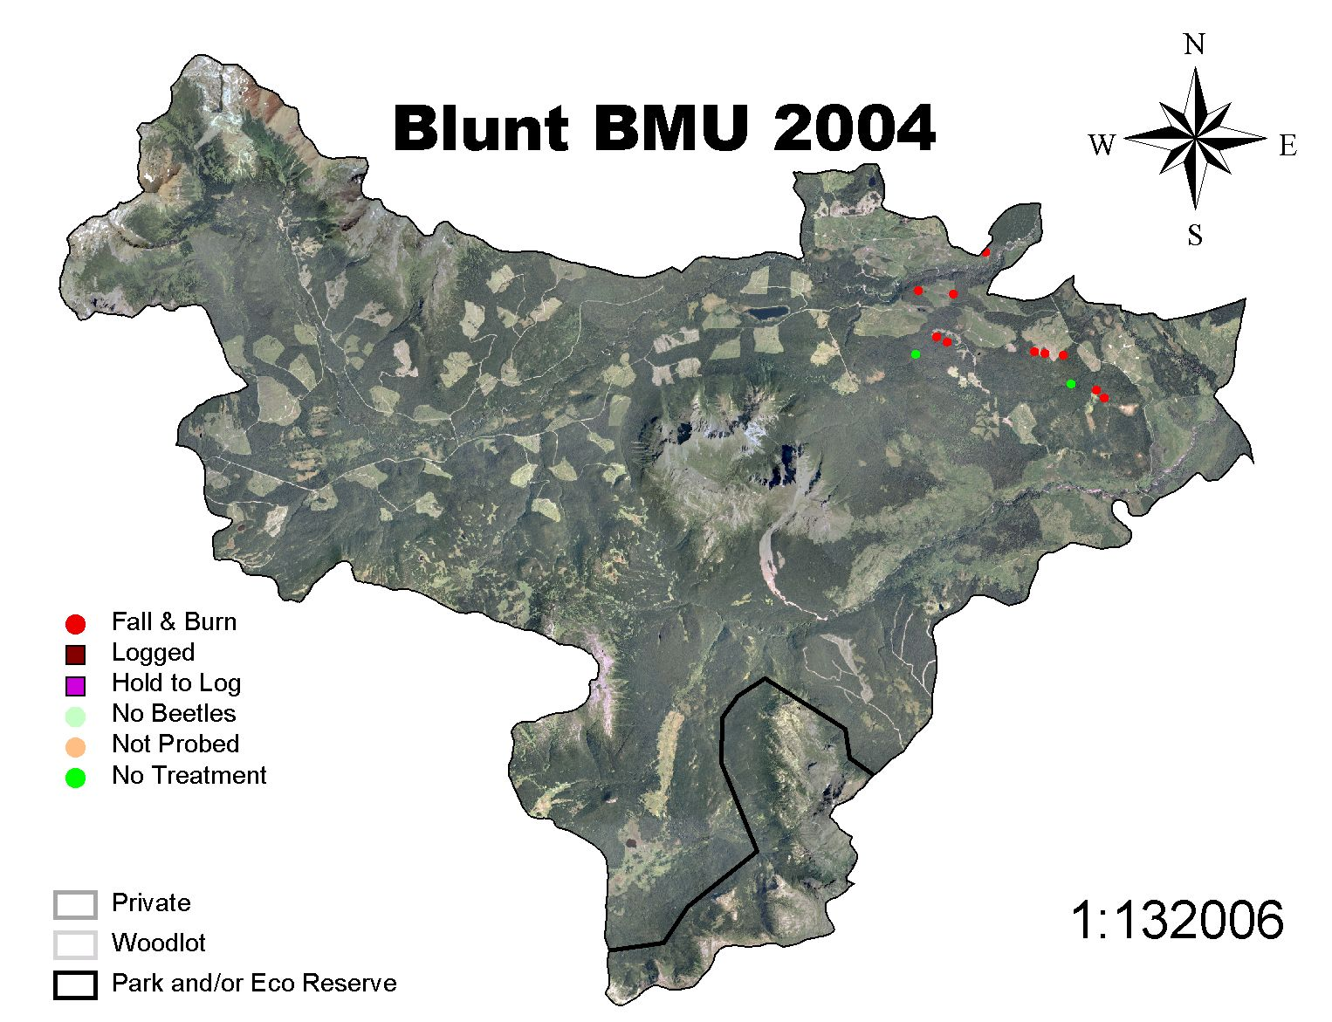
Blunt BMU 2004

Slide 8
Bulkley BMU

Slide 9
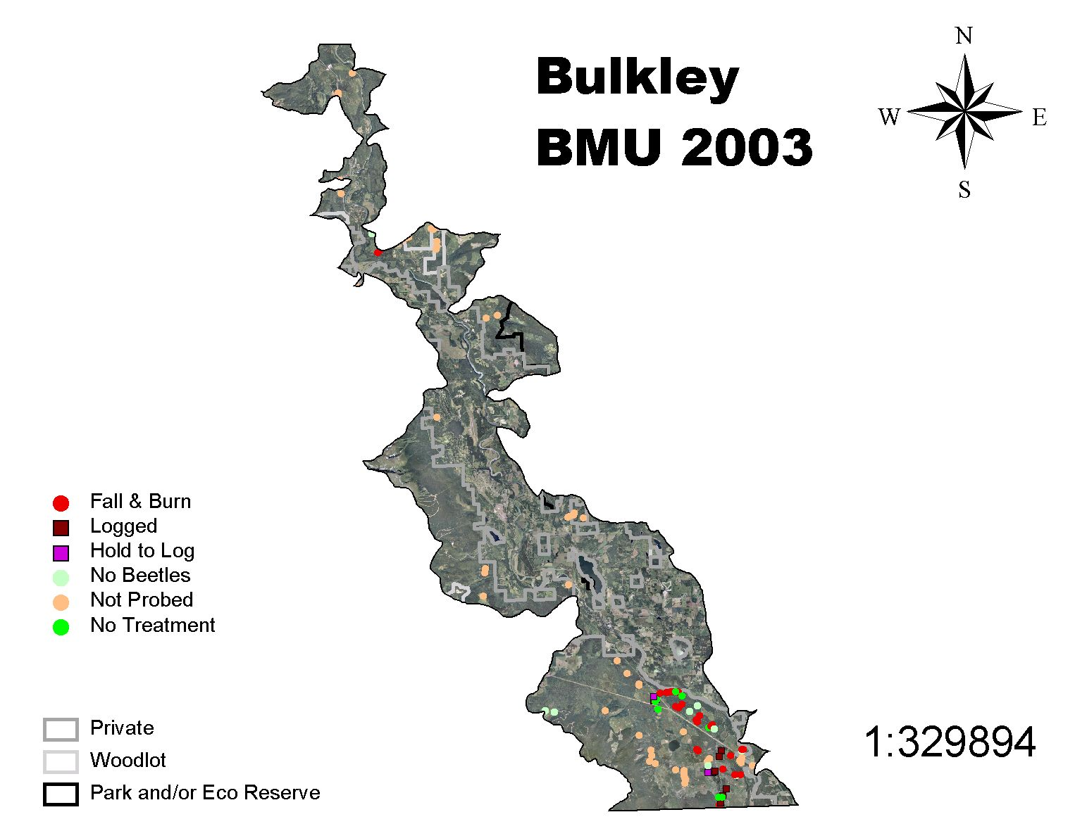
Bulkley BMU 2003

Slide 10
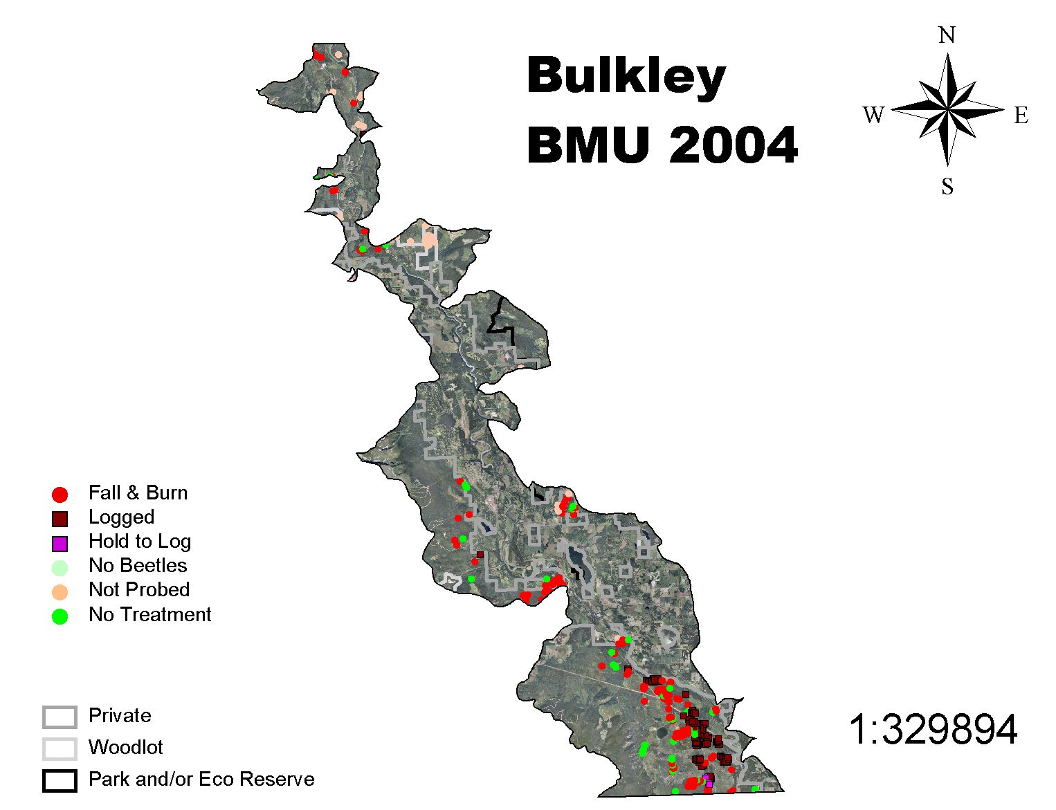
Bulkley BMU 2004

Slide 11
Chapman BMU

Slide 12
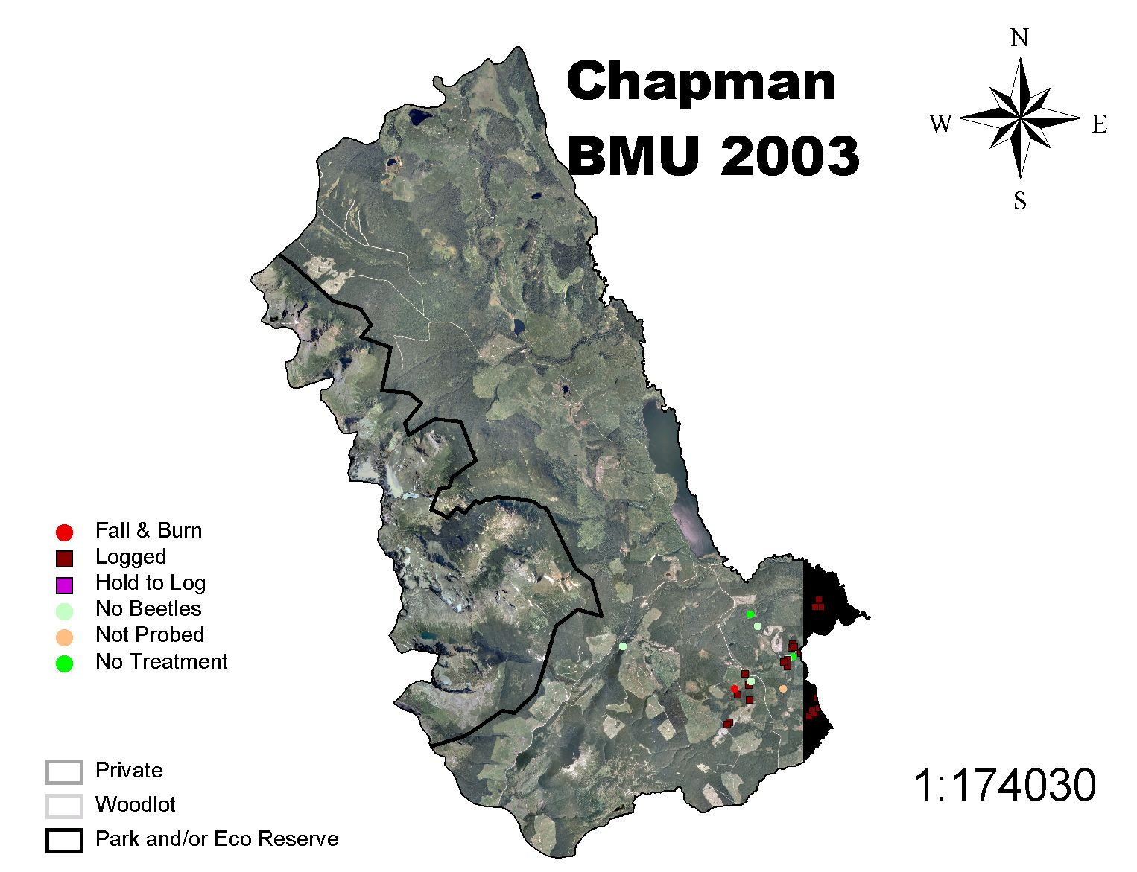
Chapman BMU 2003

Slide 13
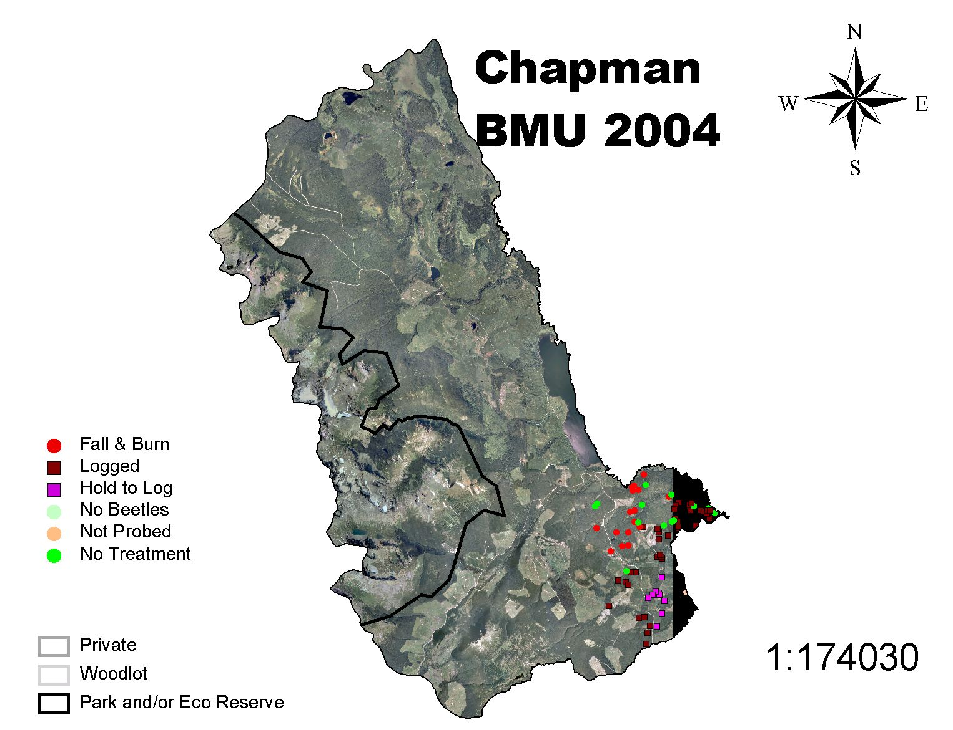
Chapman BMU 2004

Slide 14
Copper BMU

Slide 15
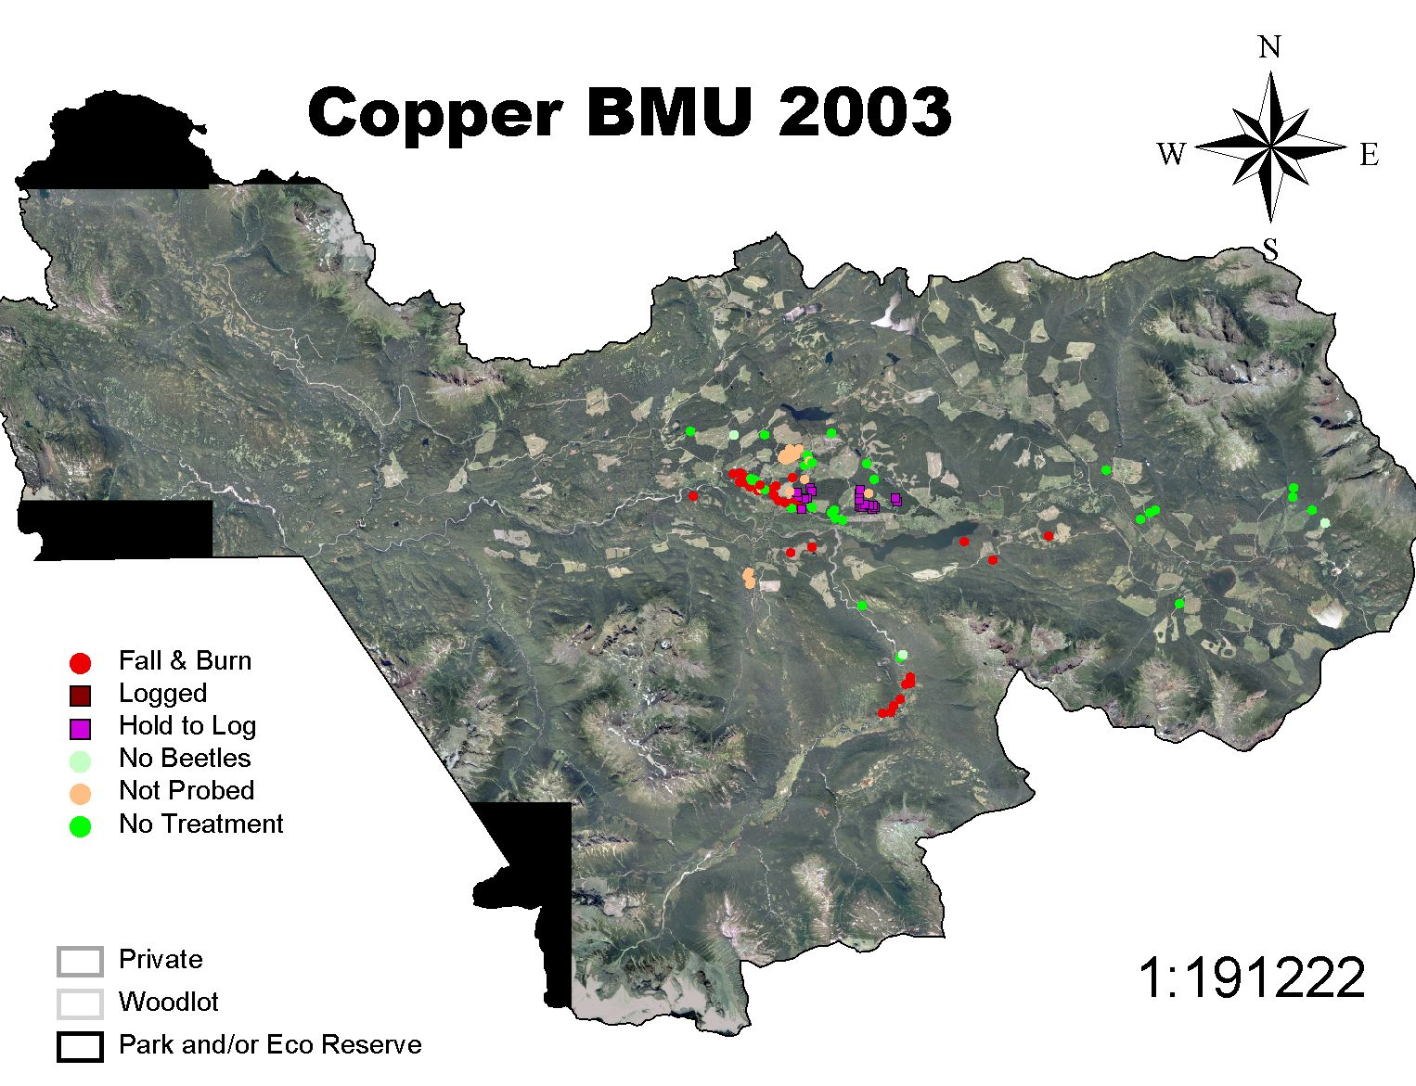
Copper BMU 2003

Slide 16

Copper BMU 2004

Slide 17
Corya BMU

Slide 18
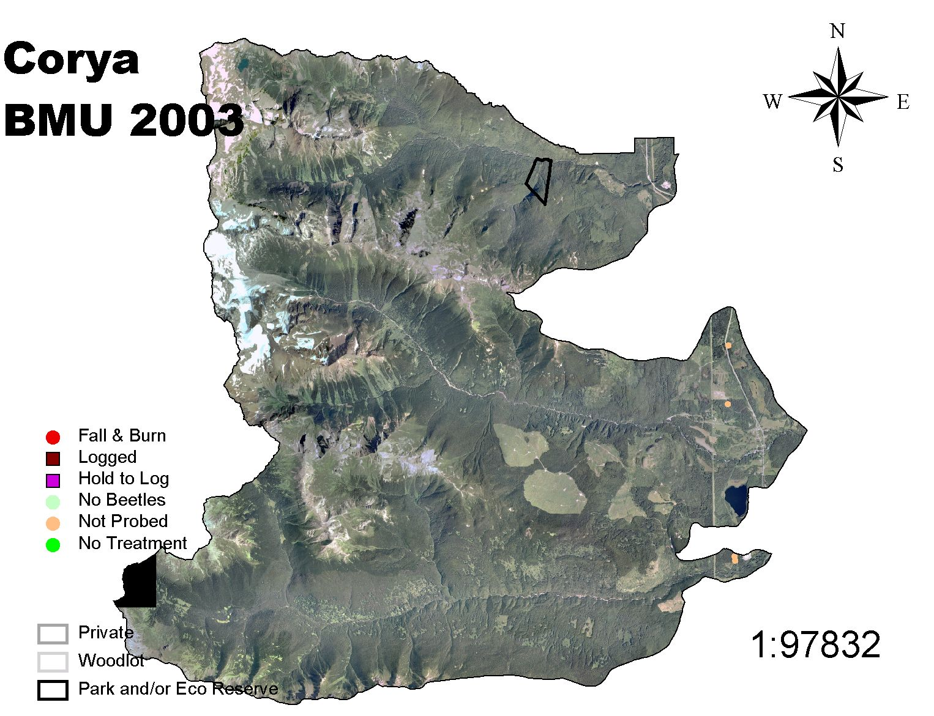
Corya BMU 2003

Slide 19
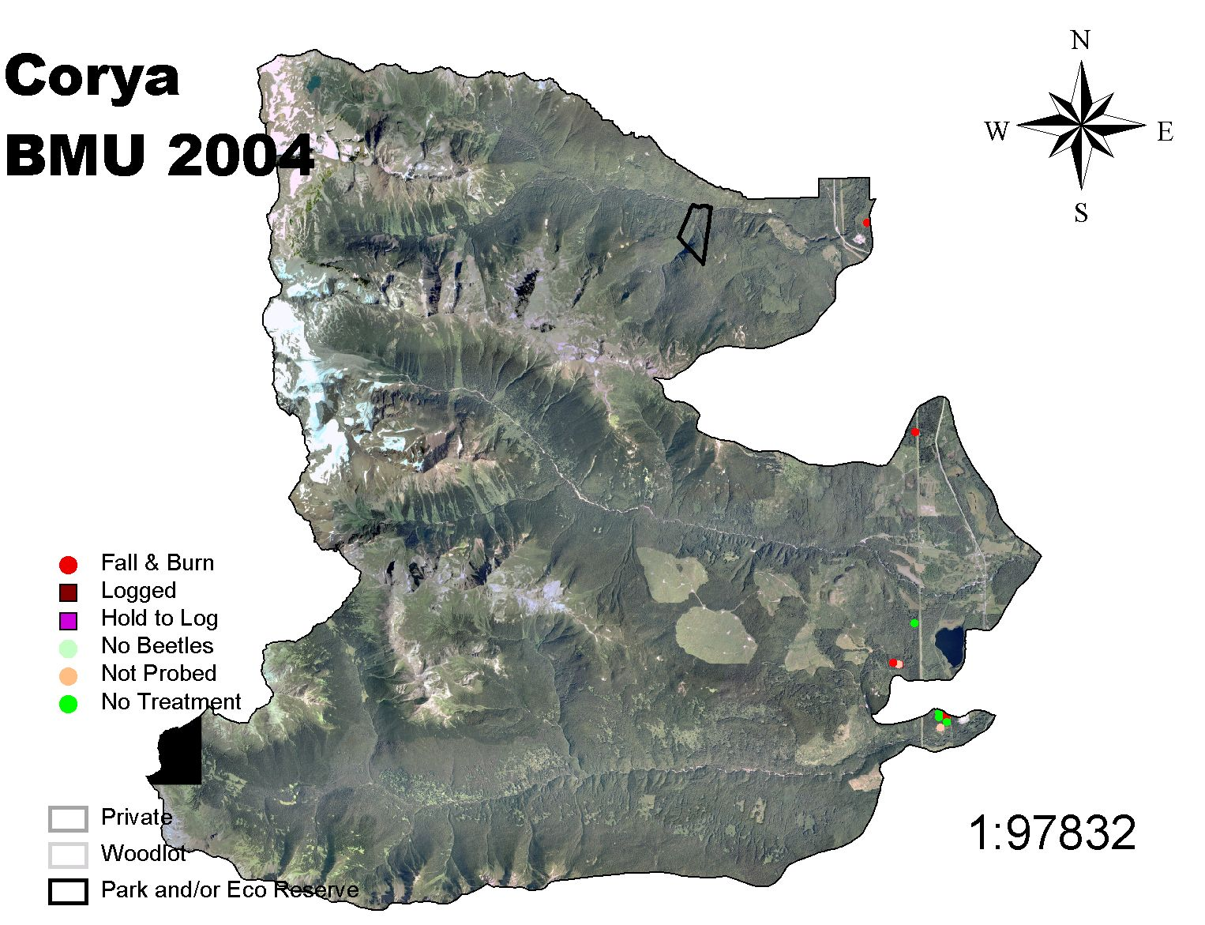
Corya BMU 2004

Slide 20
Deep Creek BMU

Slide 21
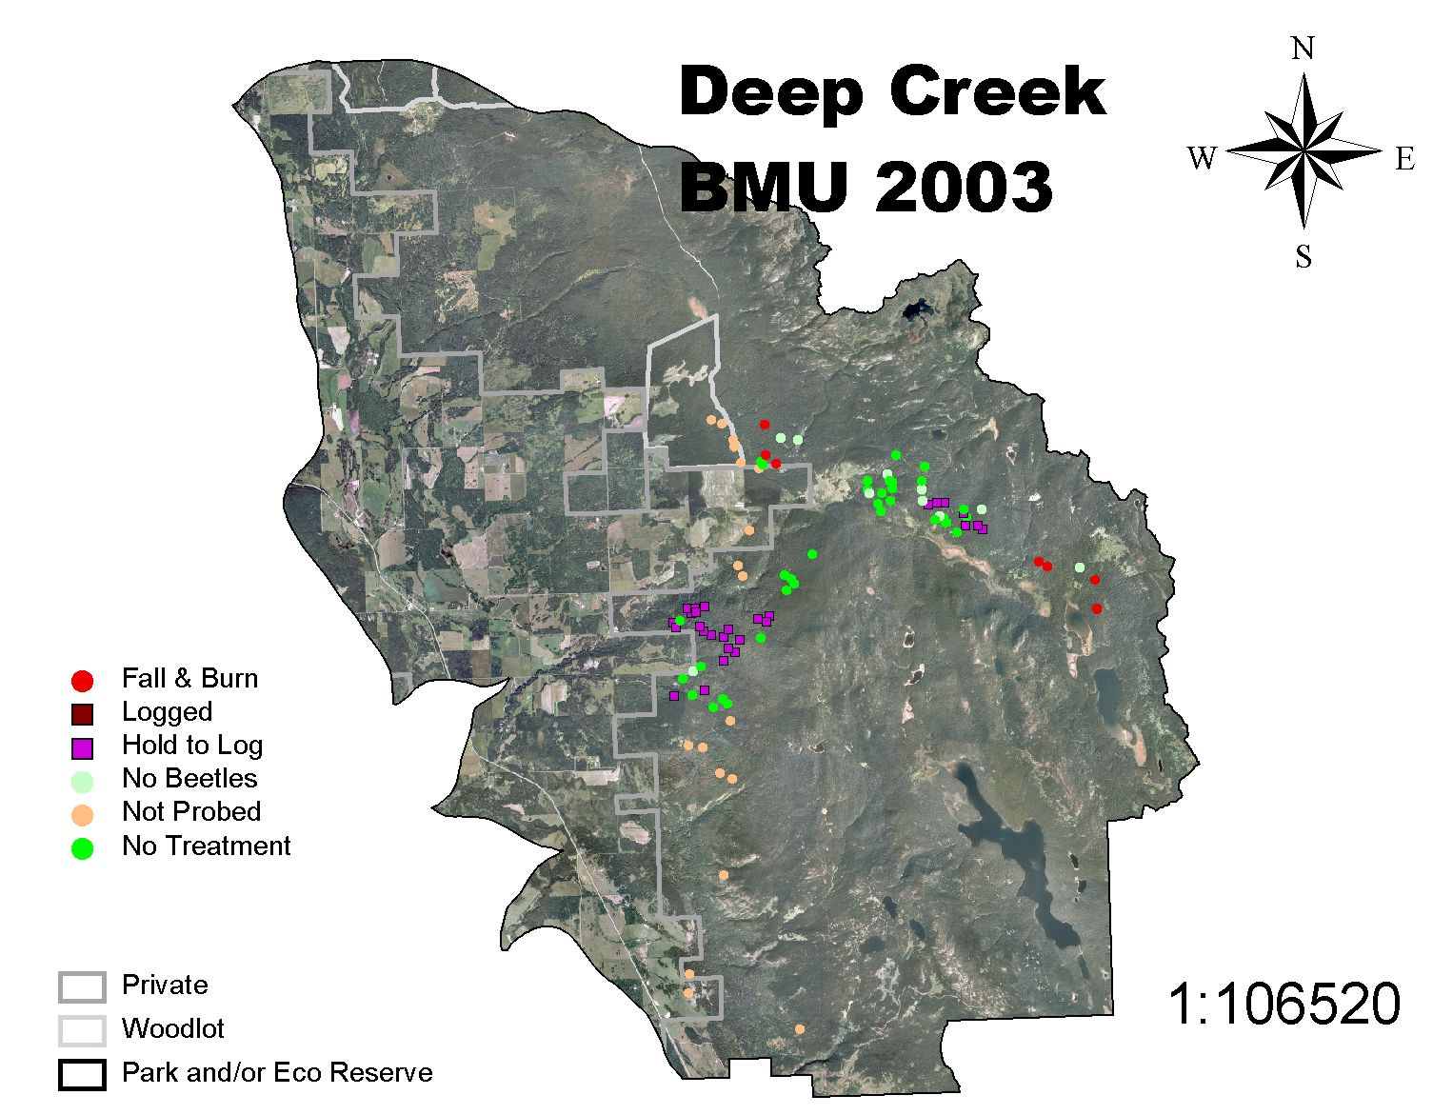
Deep Creek BMU 2003

Slide 22
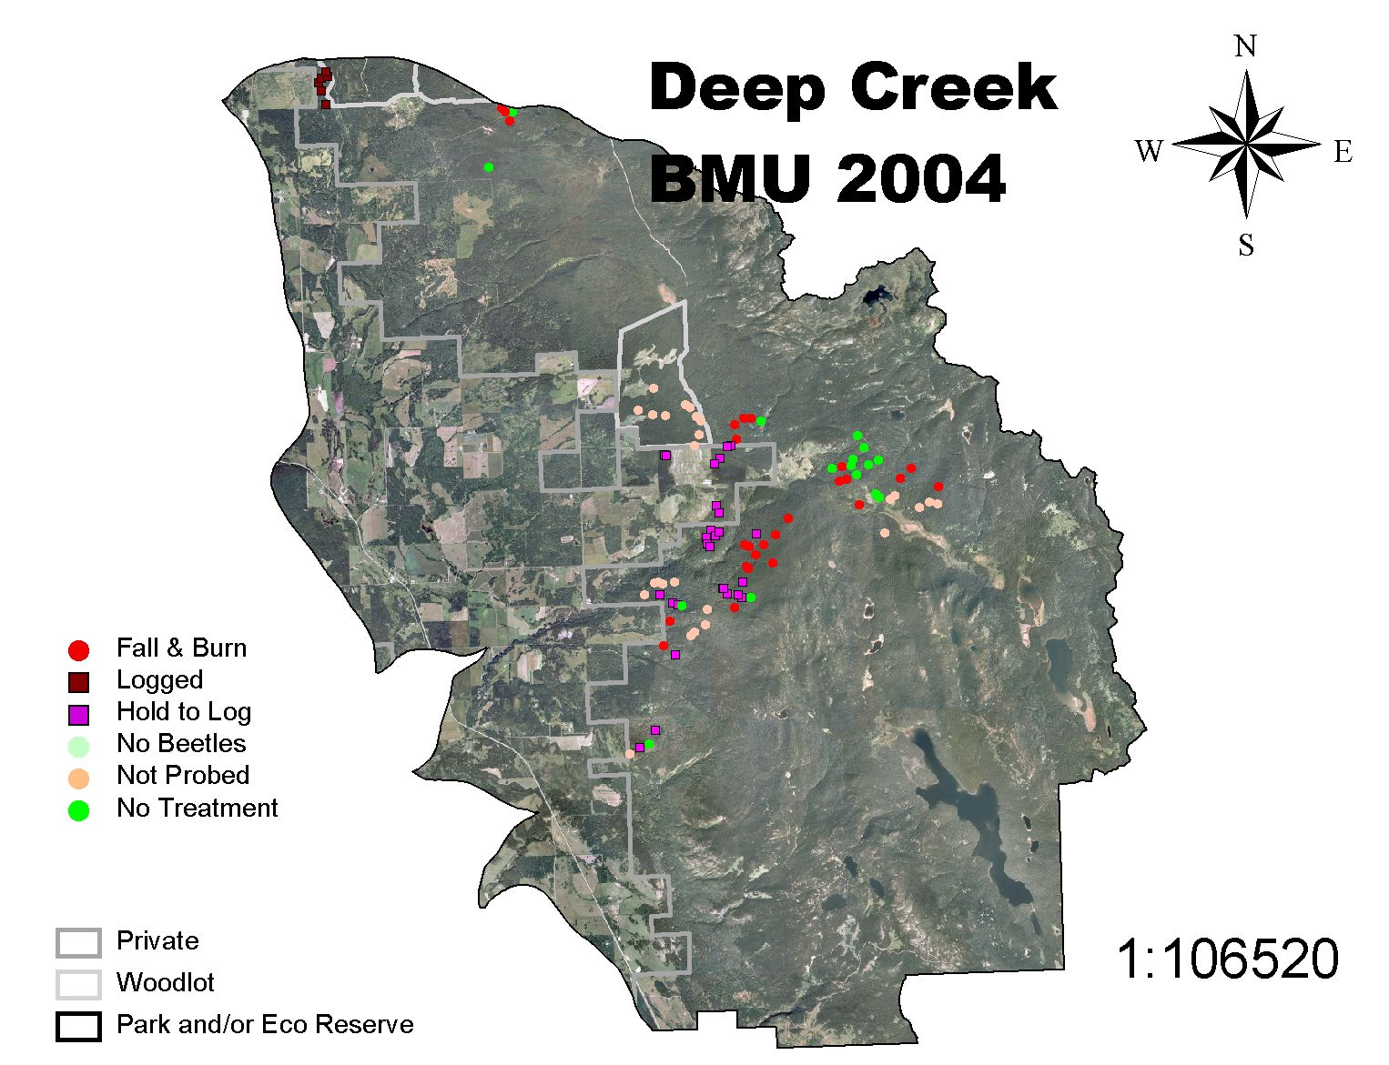
Deep Creek BMU 2004

Slide 23
Harold Price BMU

Slide 24
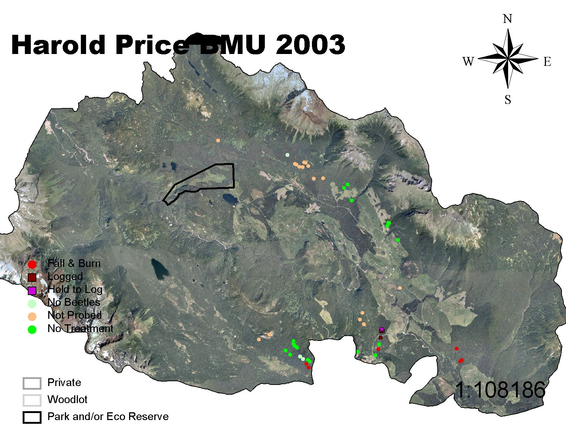
Harold Price BMU 2003

Slide 25
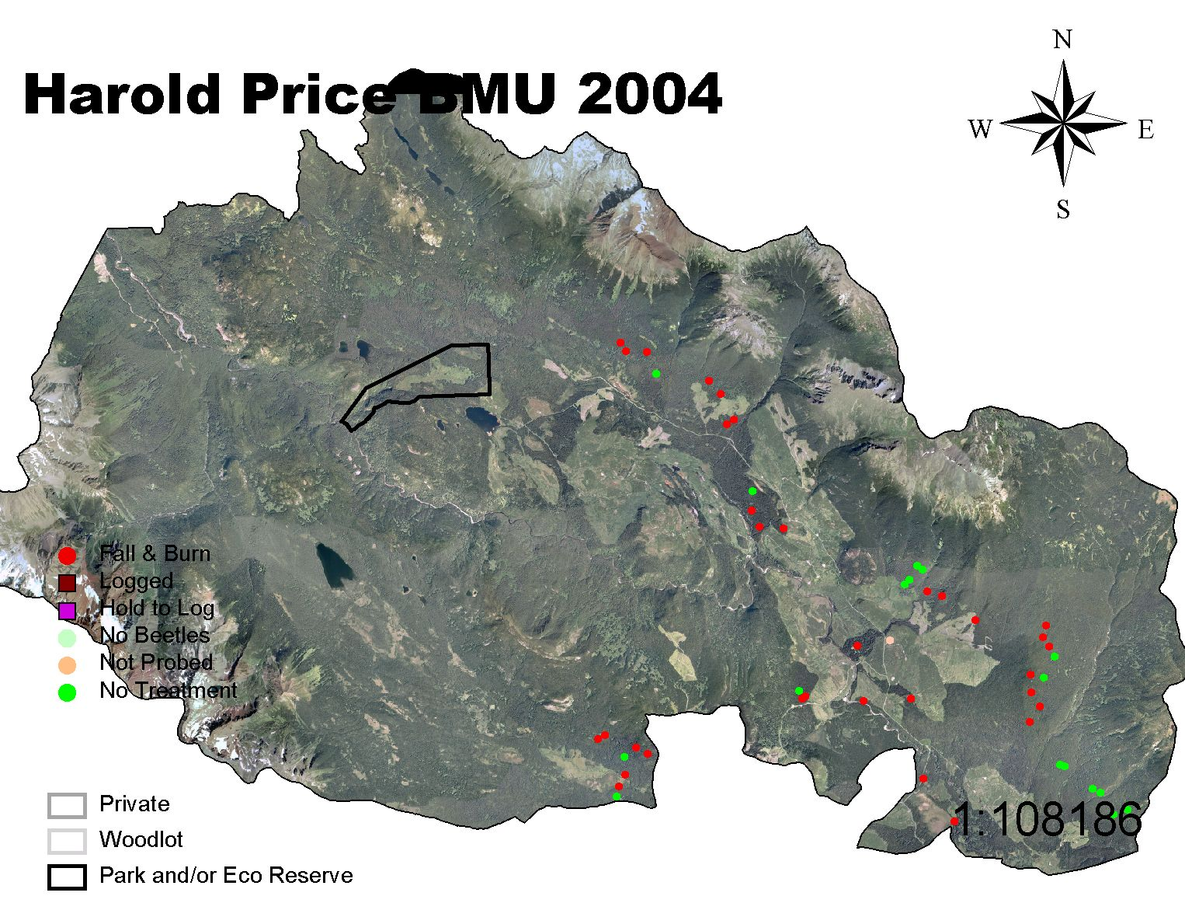
Harold Price BMU 2004

Slide 26
Reiseter BMU

Slide 27
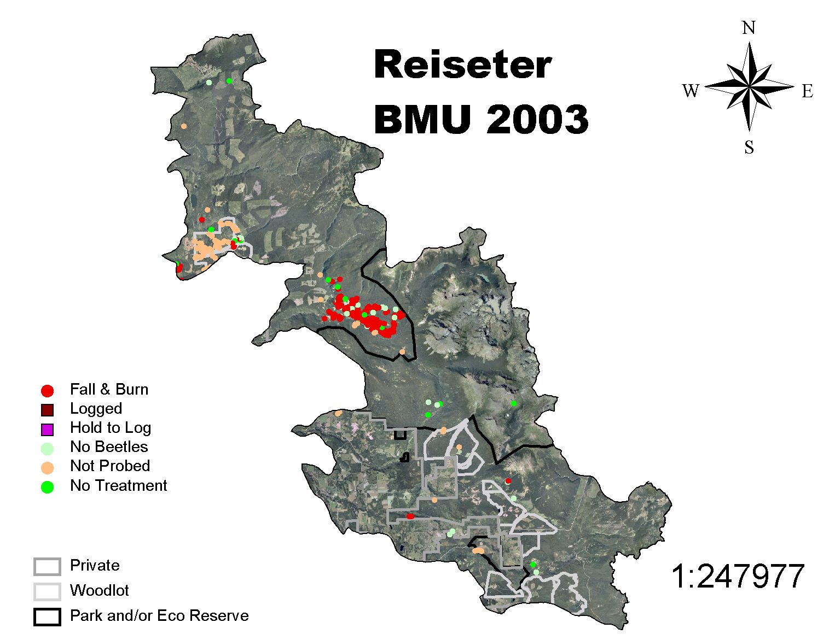
Reiseter BMU 2003

Slide 28

Reiseter BMU 2004

Slide 29
Telkwa BMU

Slide 30
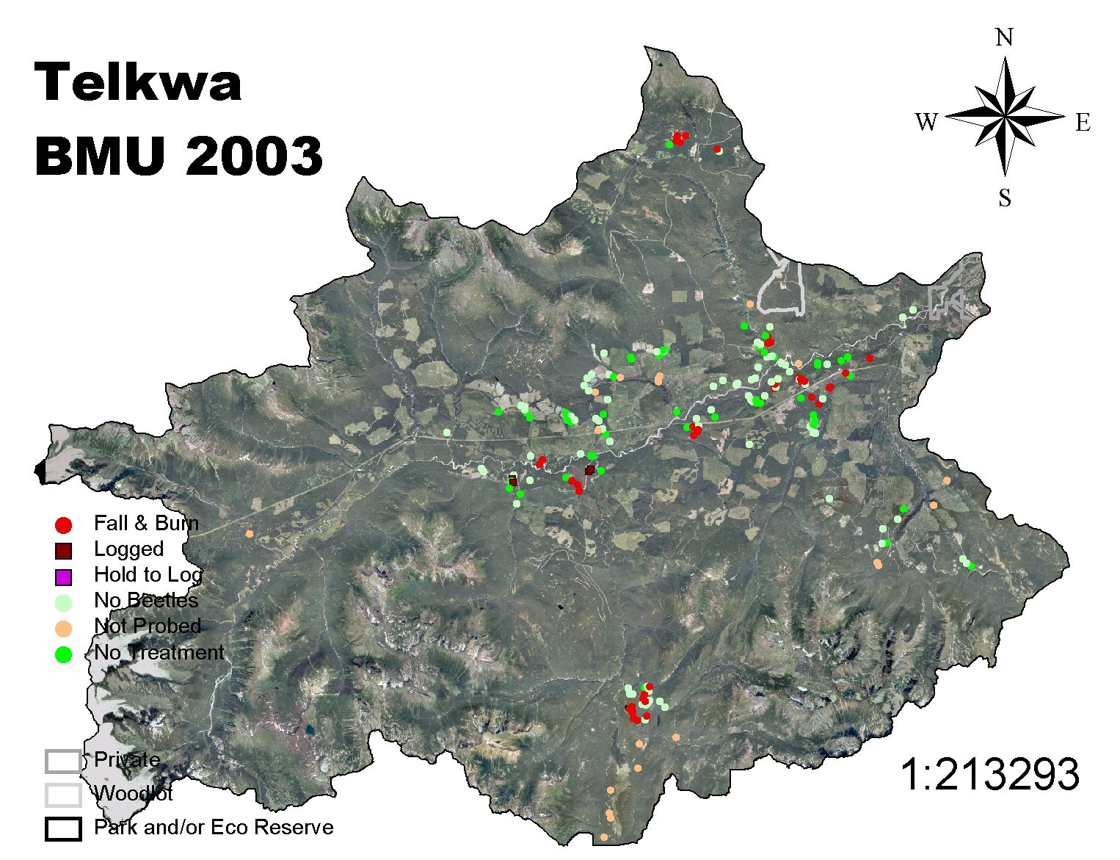
Telkwa BMU 2003

Slide 31
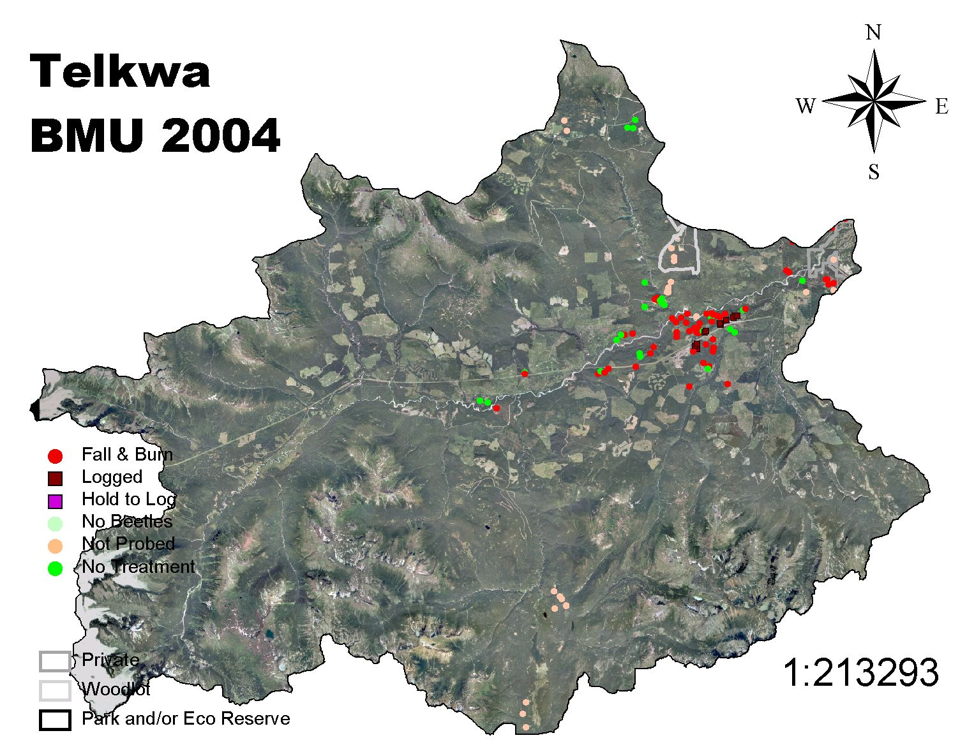
Telkwa BMU 2004

Slide 32
Torkelson BMU

Slide 33
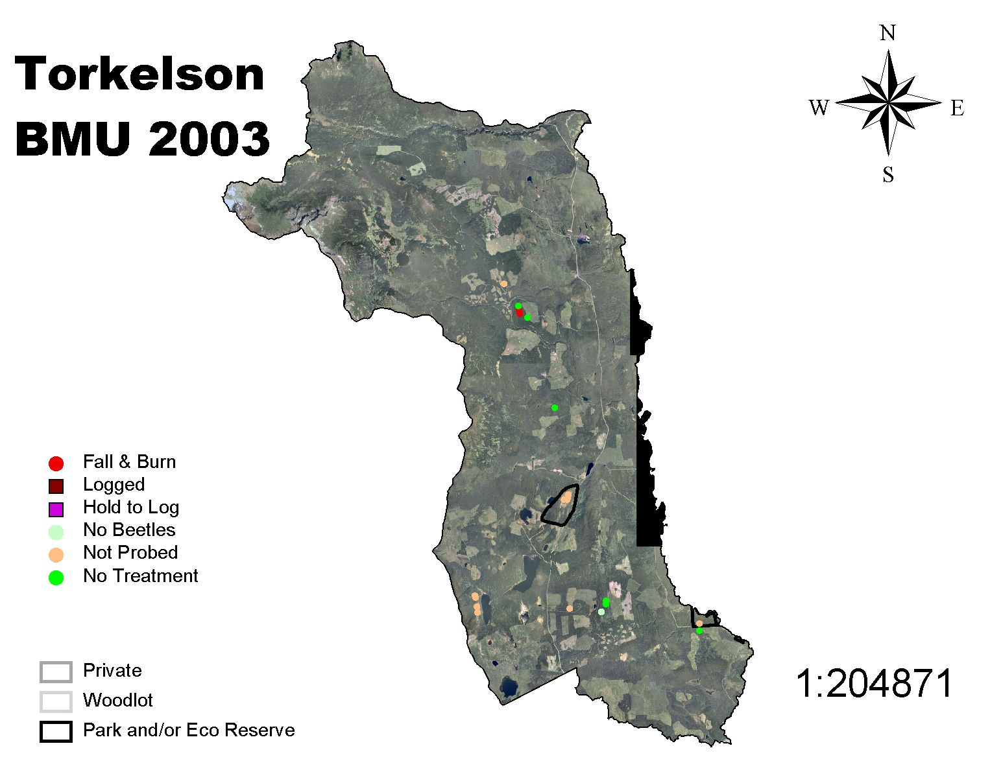
Torkelson BMU 2003

Slide 34
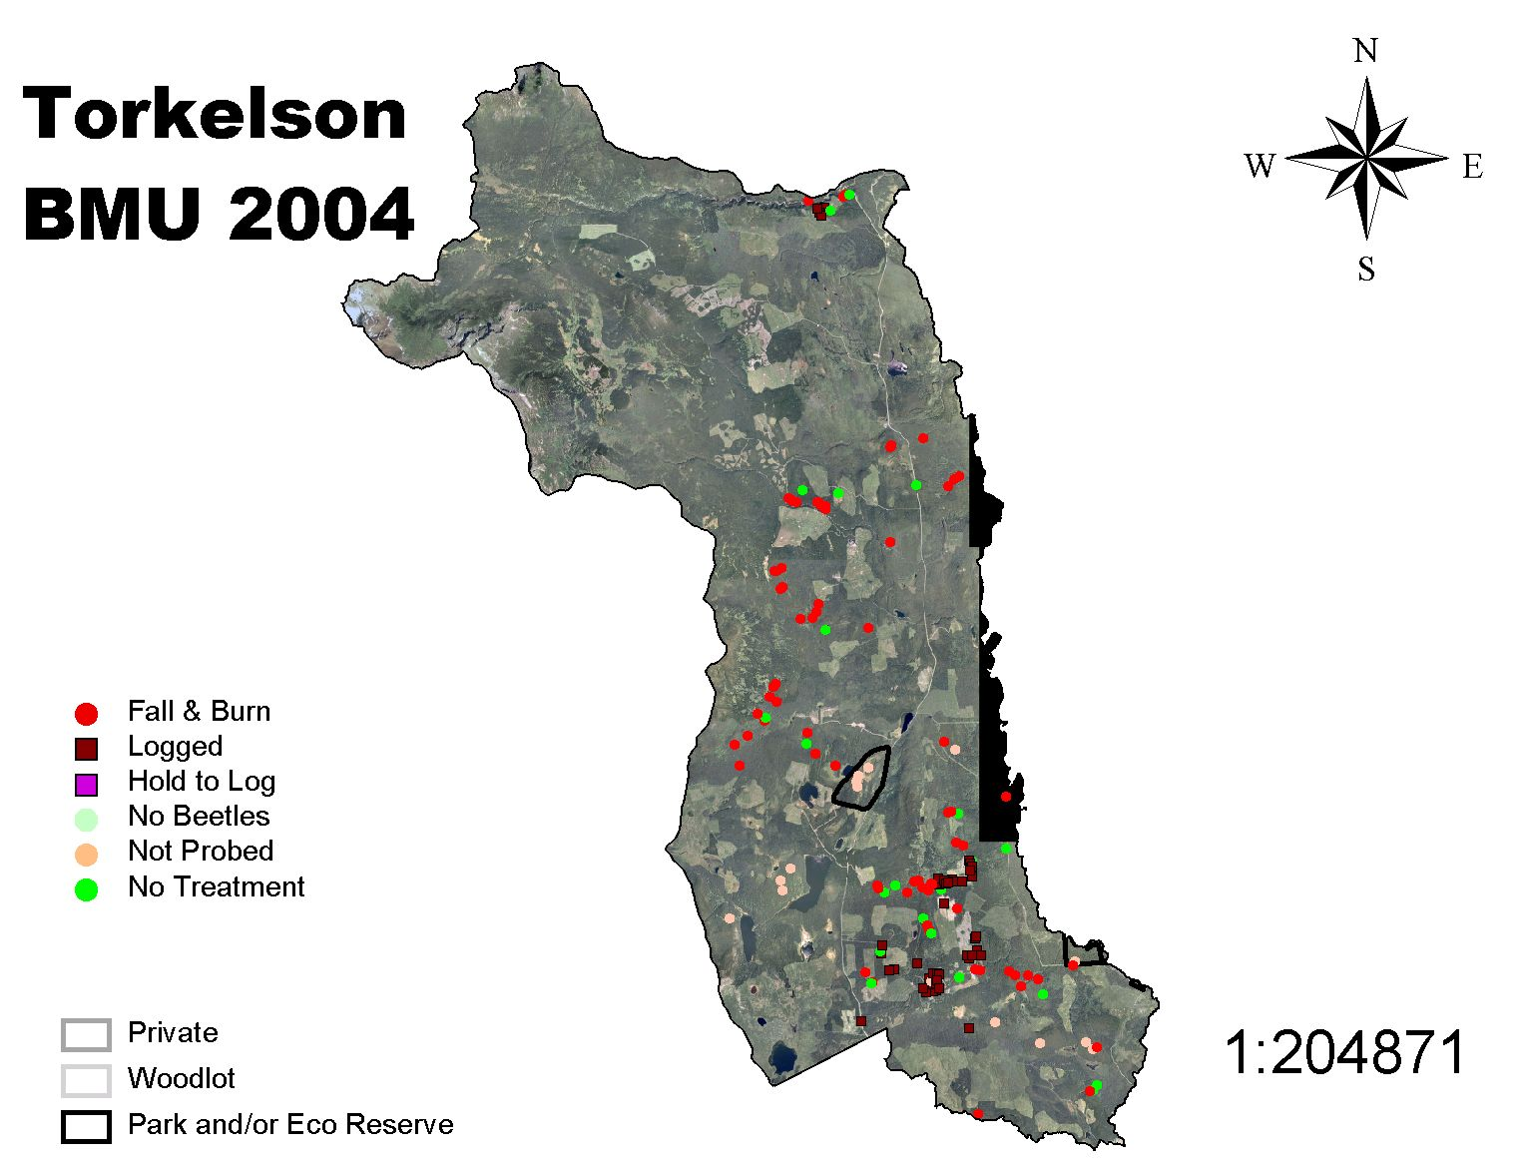
Torkelson BMU 2004

Slide 35
Trout BMU

Slide 36
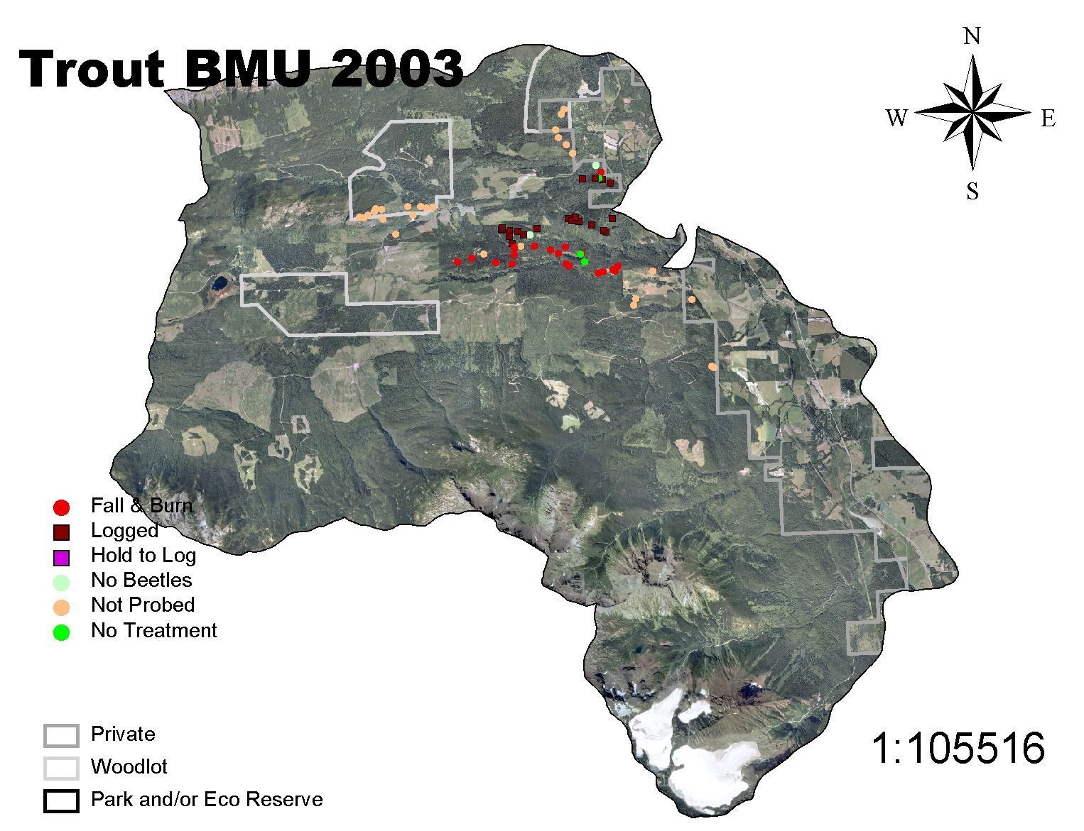
Trout BMU 2003

Slide 37
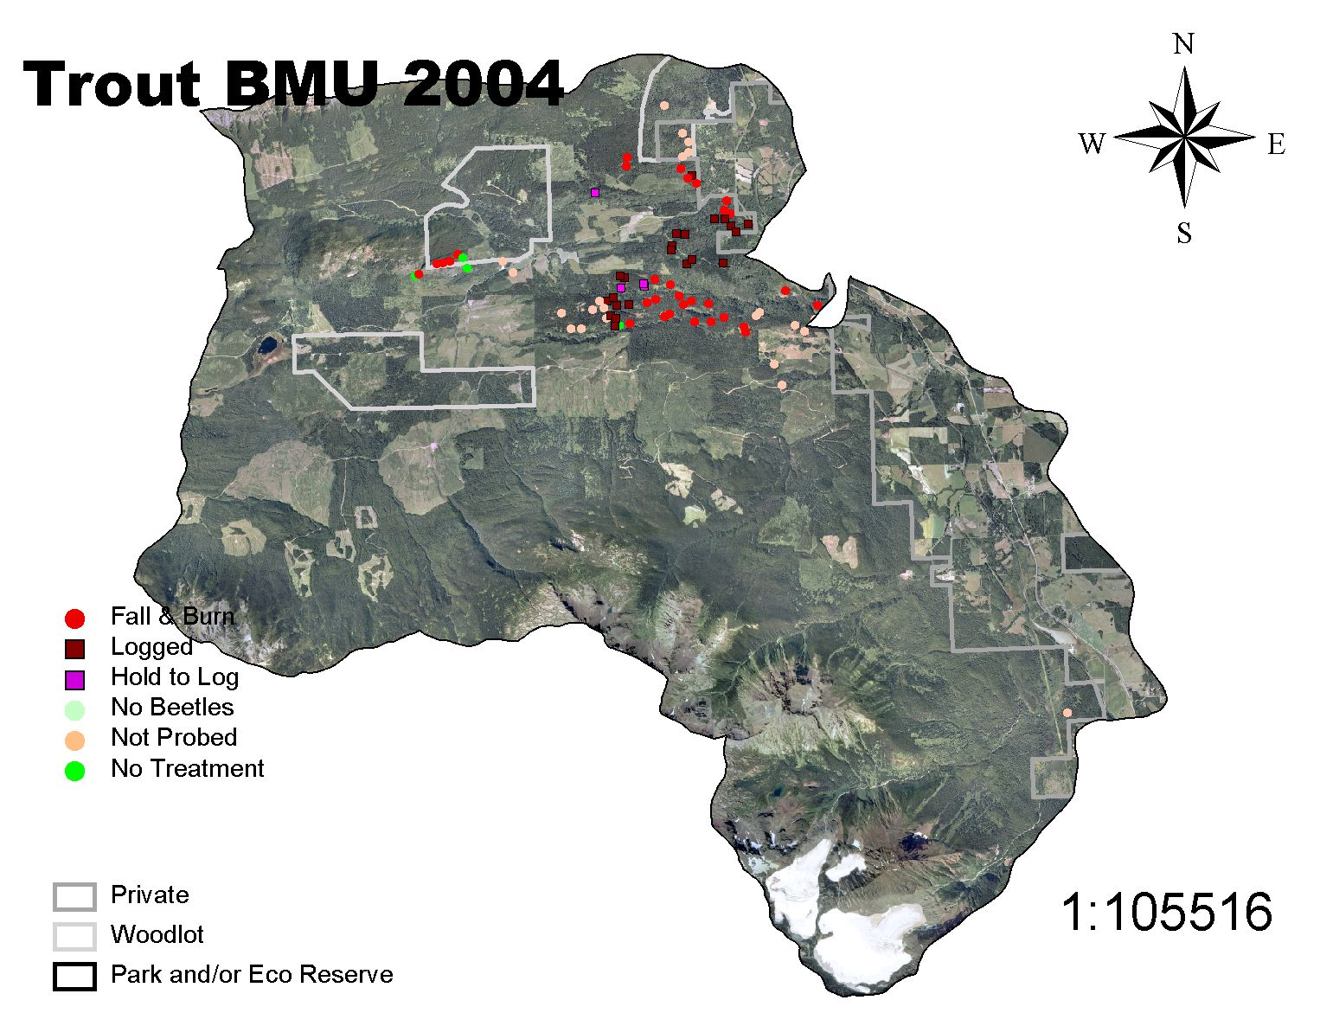
Trout BMU 2004

Slide 38
Kitseguecla BMU

Slide 39
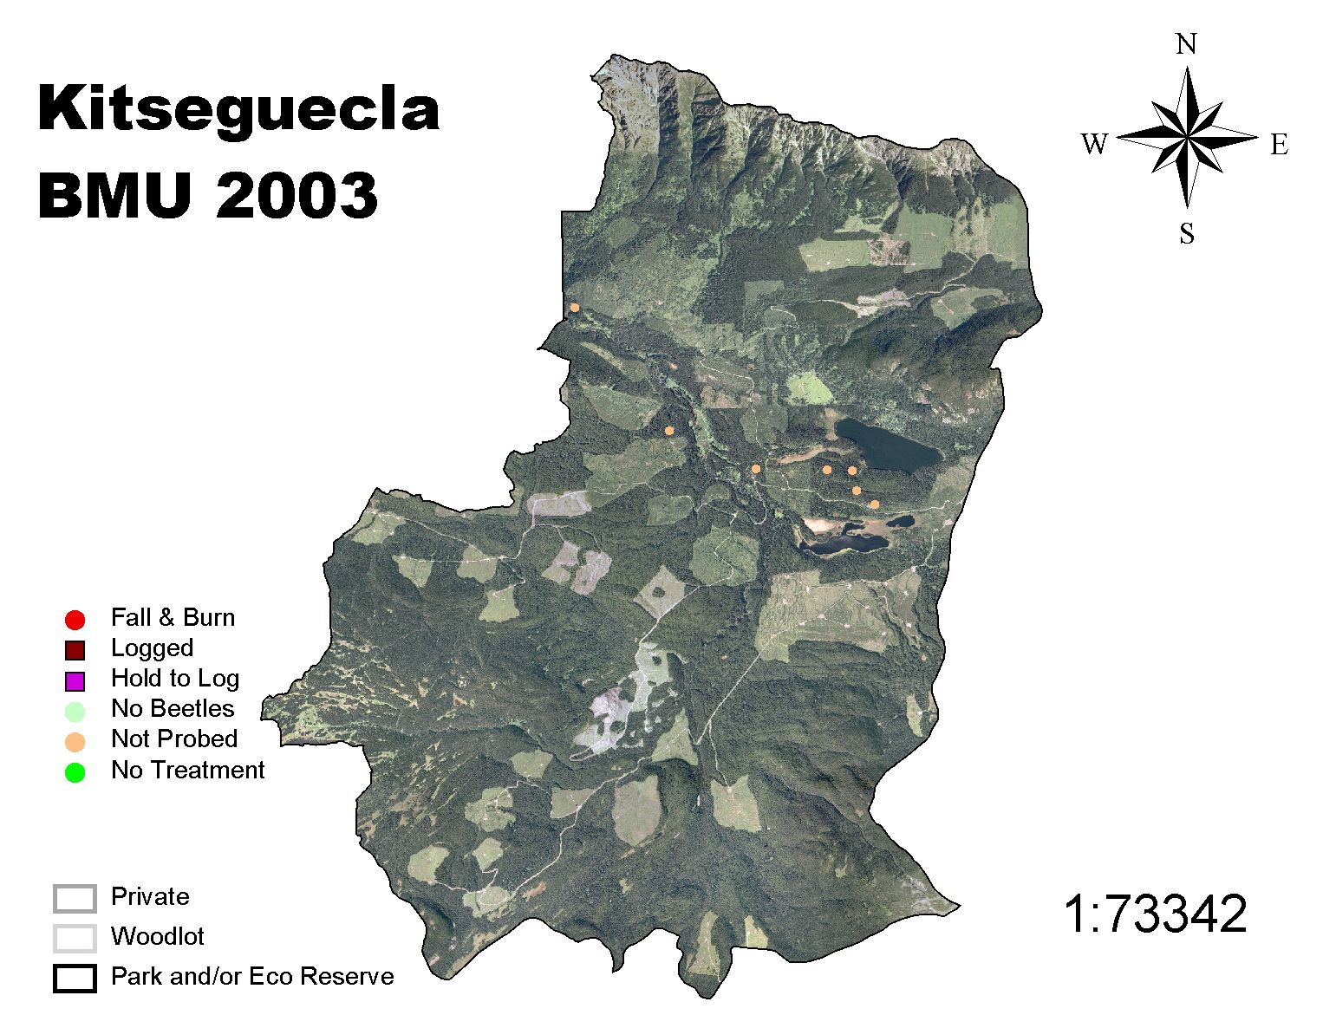
Kitseguecla BMU 2003

Slide 40
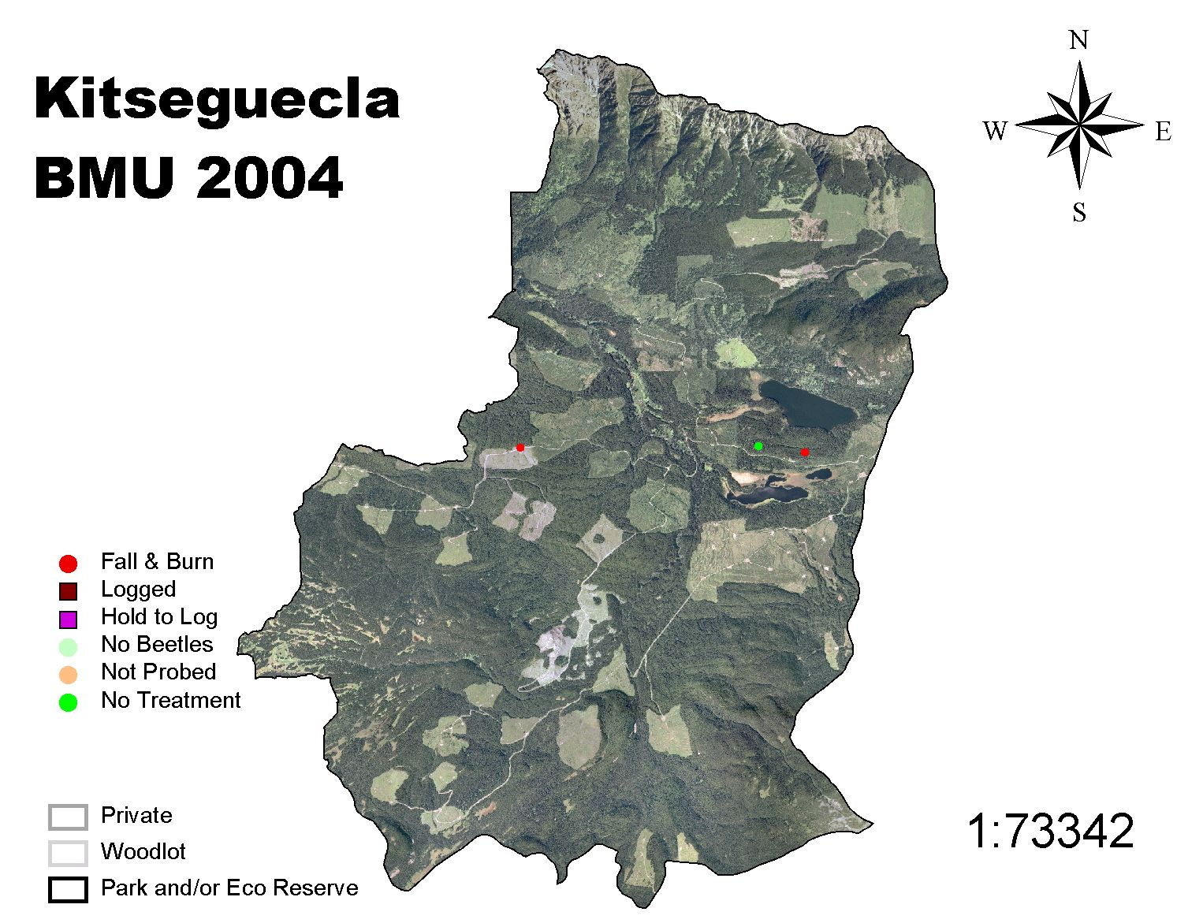
Kitseguecla BMU 2004

Slide 41
Bulkley TSA

Slide 42
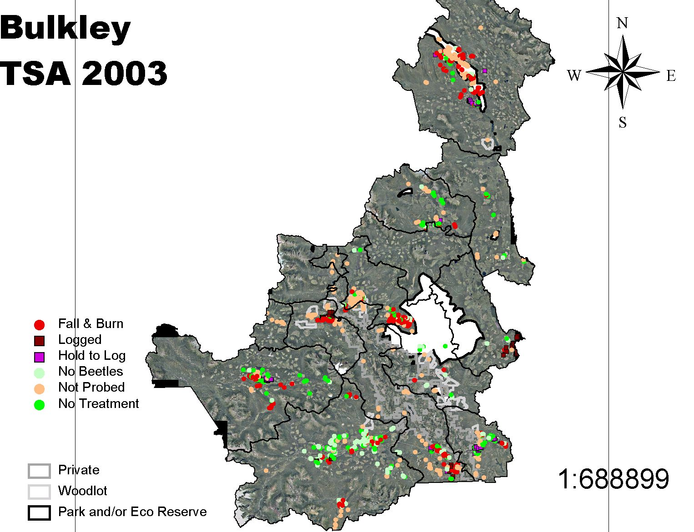
Bulkley TSA 2003

Slide 43
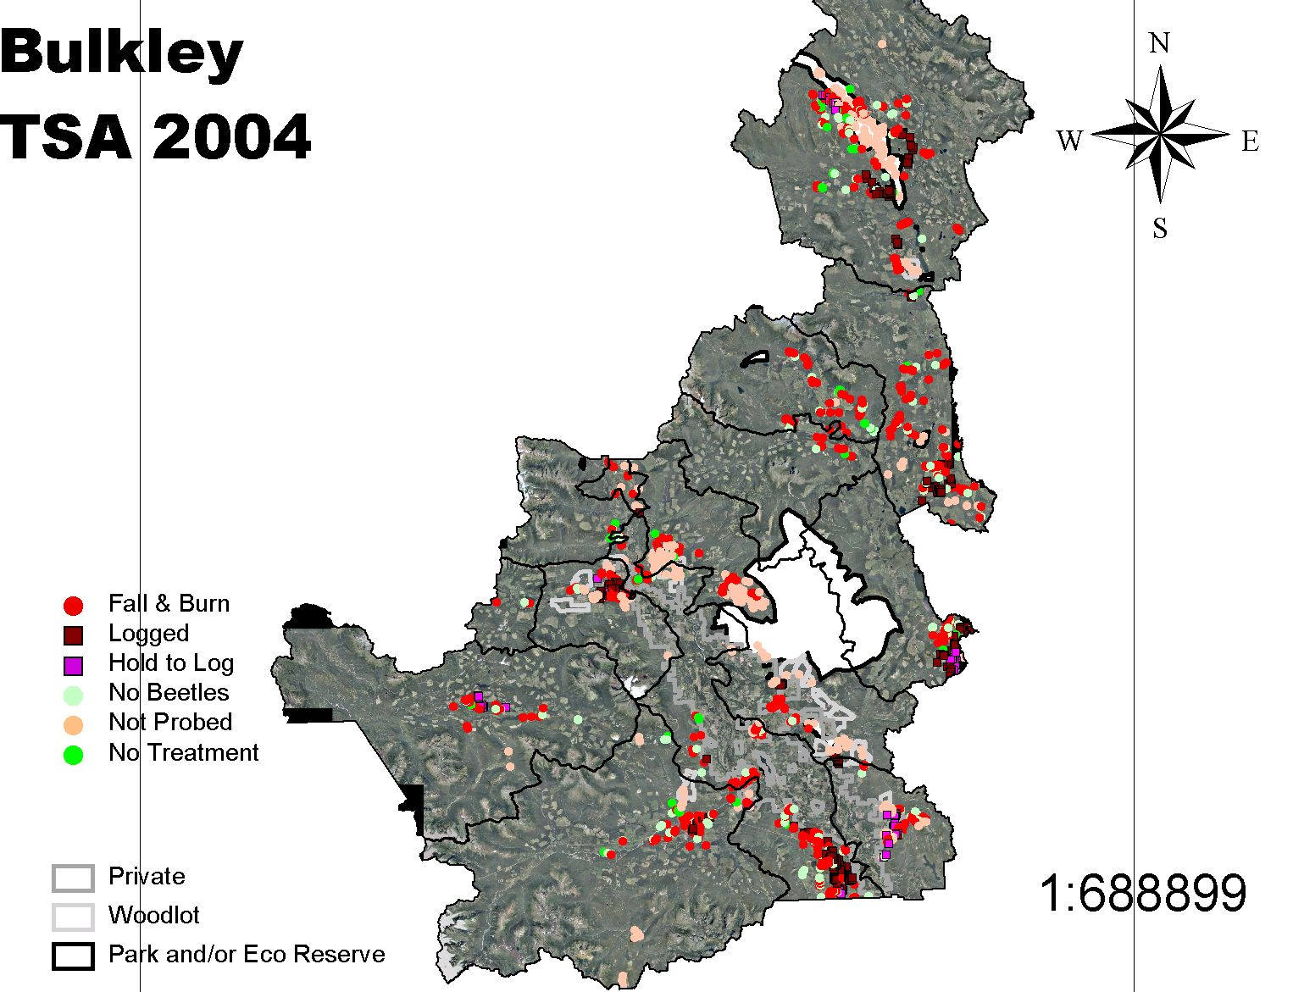
Bulkley TSA 2004

Slide 44
How Did We Do?
Babine, Blunt, Bulkley, Chapman, Corya, Harold Price, Kitseguecla, Torkelson, and Trout…
Letter Grade = A (80-100%)
Copper and Telkwa…
Letter Grade = B (70-79%)
Deep Creek and Reiseter…
Letter Grade = F (<50%)

Slide 45
How Did We Do?
Bulkley TSA for 2003…
  Letter Grade = C (61%)
Bulkley TSA for 2004…
  Letter Grade = B (75%)

Slide 46
General Observations...
The 100 meter probing radius utilized during 2004 was a lot more effective in discovering infested trees.
Tendering probing work on an “all found basis” tends to compromise overall probing quality.
Confusion still exists around treating CMT’s with a fall and burn treatment.

Slide 47
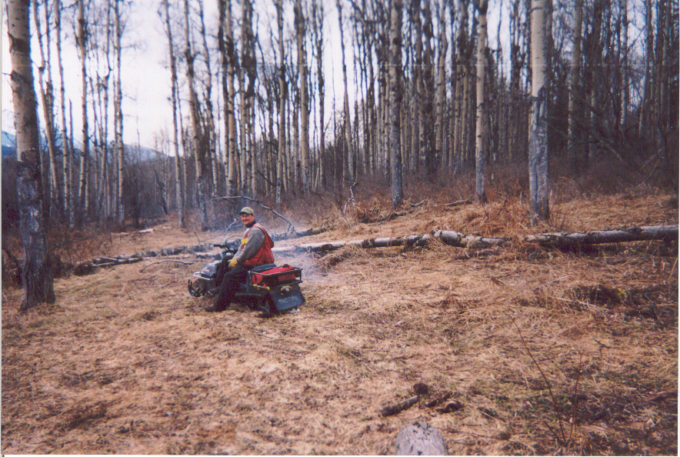
General Observations...

Slide 48
General Observations...
It is scary using fire when the snow has melted!
A central data base, while expensive to maintain is critical for tracking program performance.
Finally… More money equals more success!

Slide 49
Contact Info!
For more information on the two year (2003-2004) beetle management period in the Bulkley TSA know as DFAM please contact:
Dave Ripmeester, RPF, PIR. (250) 847-2656
Carl Vandermark, RPF, CANFOR (250) 845-5271
Steve Willis, RPF, BCTS. (250) 847-6300
Or Jay Baker, Silvicon Services Inc. (250) 847-3680

Slide 50
Babine River Park

Slide 51
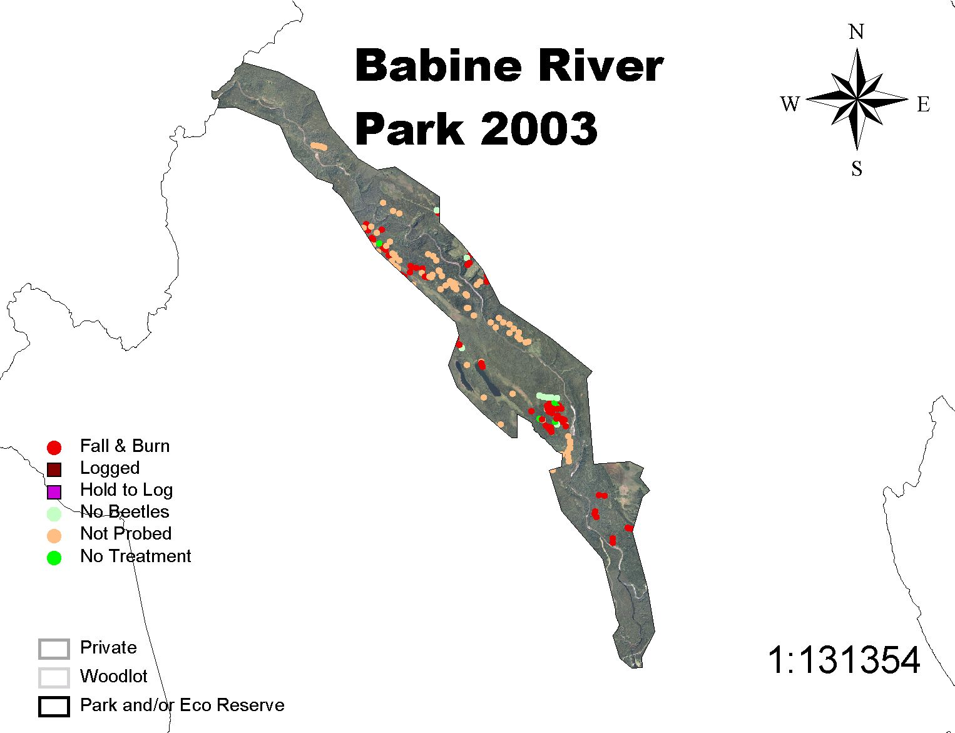
Babine River Park 2003

Slide 52
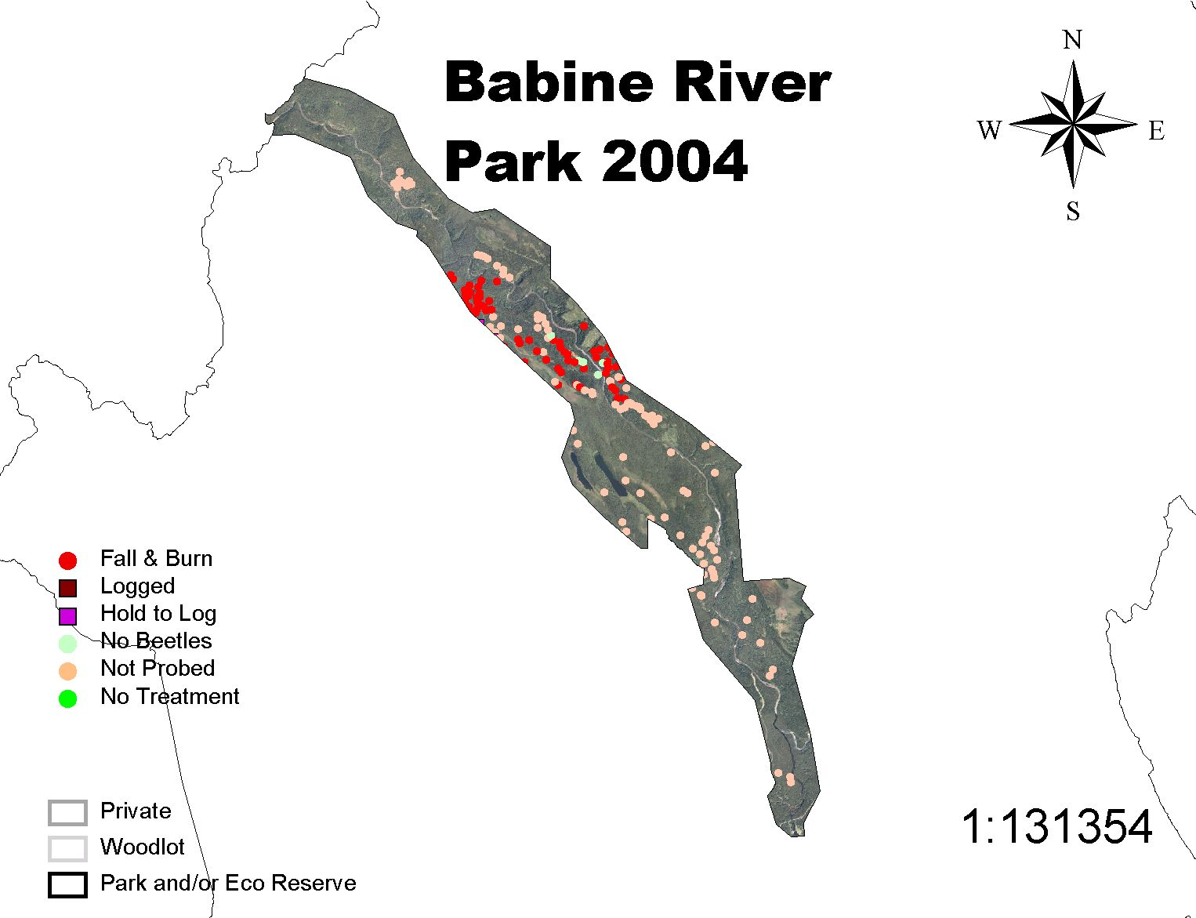
Babine River Park 2004

